Slide 1
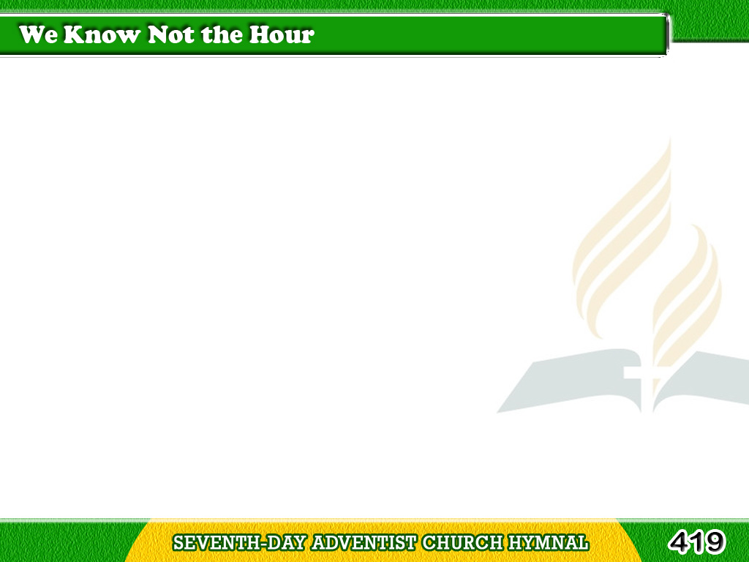
1/3
We know not the hour
of the Master’s appearing;
Yet signs all foretell
that the moment is nearing
Tagalog
Version

Slide 2
1/3
When He shall return
‘tis a promise most cheering
But we know not the hour.
Tagalog
Version

Slide 3
1/3
Chorus
He will come,
let us watch and be ready;
He will come,
hallelujah! hallelujah!
Tagalog
Version

Slide 4
1/3
Chorus
He will come in the clouds of
His Father’s bright glory
But we know not the hour.
Tagalog
Version

Slide 5
2/3
There’s light for the wise
who are seeking salvation;
There’s truth in the book
of the Lord’s revelation;
Tagalog
Version

Slide 6
2/3
Each prophecy points
to the great consummation
But we know not the hour.
Tagalog
Version

Slide 7
2/3
Chorus
He will come,
let us watch and be ready;
He will come,
hallelujah! hallelujah!
Tagalog
Version

Slide 8
2/3
Chorus
He will come in the clouds of
His Father’s bright glory
But we know not the hour.
Tagalog
Version

Slide 9
3/3
We’ll watch and we’ll pray,
with our lamps trimmed
and burning;
We’ll work and we’ll wait
till the Master’s returning;
Tagalog
Version

Slide 10
3/3
We’ll sing and rejoice,
every omen discerning
But we know not the hour.
Tagalog
Version

Slide 11
3/3
Chorus
He will come,
let us watch and be ready;
He will come,
hallelujah! hallelujah!
Tagalog
Version

Slide 12
3/3
Chorus
He will come in the clouds of
His Father’s bright glory
But we know not the hour.
Tagalog
Version

